Slide 1
Network Layer in Computer
Networks

Slide 2
Index
,
Concept of IP Packet and Addresses
IPV4 Protocol Format
Routing Algorithm- Distance Vector Routing
Link State Routing

Slide 3
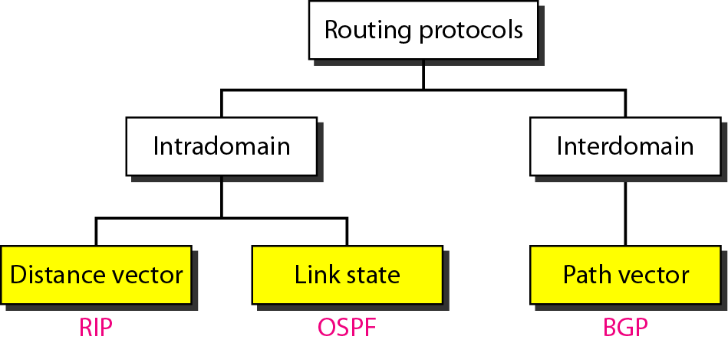
Popular routing protocols

Slide 4
Distance Vector Routing:
So far we have studied Static Routing Algorithms. But practically dynamic Routing Algorithms are used. Following two are Dynamic Routing Algorithms:
1. Distance Vector Routing Algorithm.
2. Link State Routing Algorithm.
Distance Vector Routing Algorithm:
At each step within a router:
Get routing tables from neighbours
Compute distance to neighbours
Compute new routing table
Router transmits its distance vector to each of its neighbors.
Each router receives and saves the most recently received distance vector from each of its neighbors.
A router recalculates its distance vector when:
It receives a distance vector from a neighbor containing different information than before.
It discovers that a link to a neighbor has gone down (i.e., a topology change).
The DV calculation is based on minimizing the cost to each destination.
The distance vector routing algorithm is sometimes called by other names, the distributed Bellman-Ford routing algorithm and the Ford-Fulkerson algorithm.

Slide 5
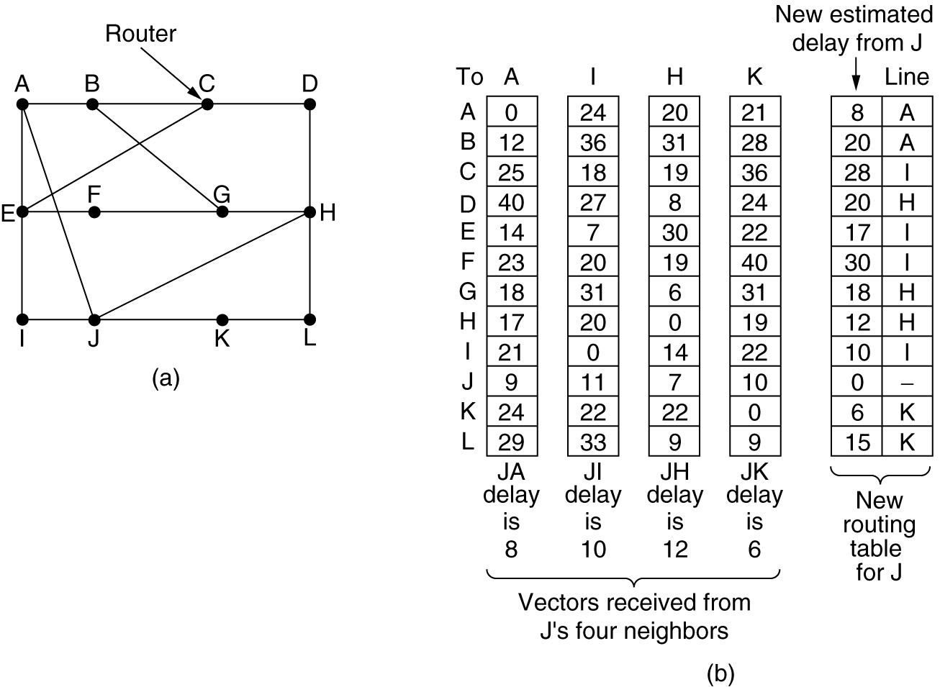
Distance Vector Routing
(a) A subnet. (b) Input from A, I, H, K, and the new
routing table for J.

Slide 6
Drawback of Distance Vector Routing
Drawback of Distance Vector Routing:
Count to Infinity Problem:
It reacts rapidly to good news,
But, leisurely to bad news.
Updates value fast when neighbor is down, but not when neighbor is again up. How?
Lie to neighbour about distance if routing via neighbour
The core of the problem is that when X tells Y that it has a path somewhere, Y has no way of knowing whether it itself is on the path? This is how problem is created.
It does not take bandwidth into account.
Take too long to converge changes in one node to all other nodes.
Solution?
Link State Routing.

Slide 7
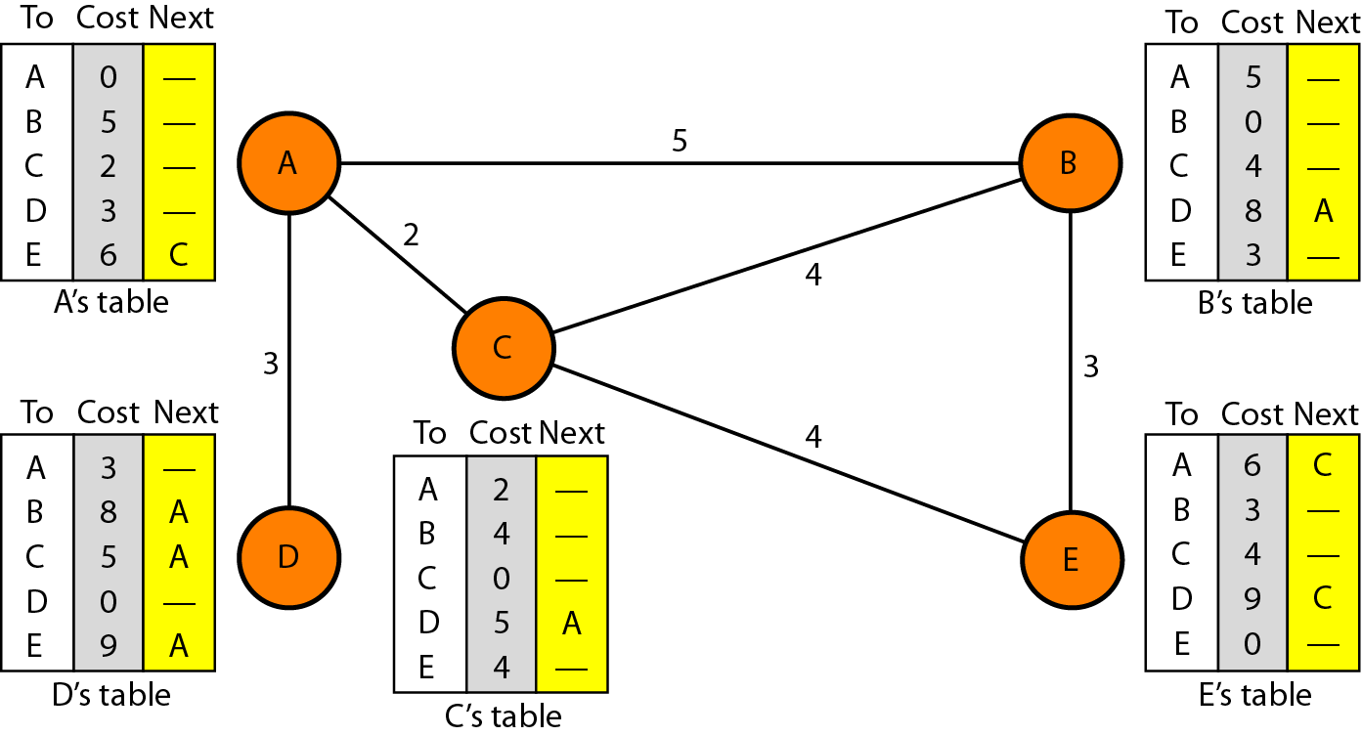
Distance vector routing tables

Slide 8
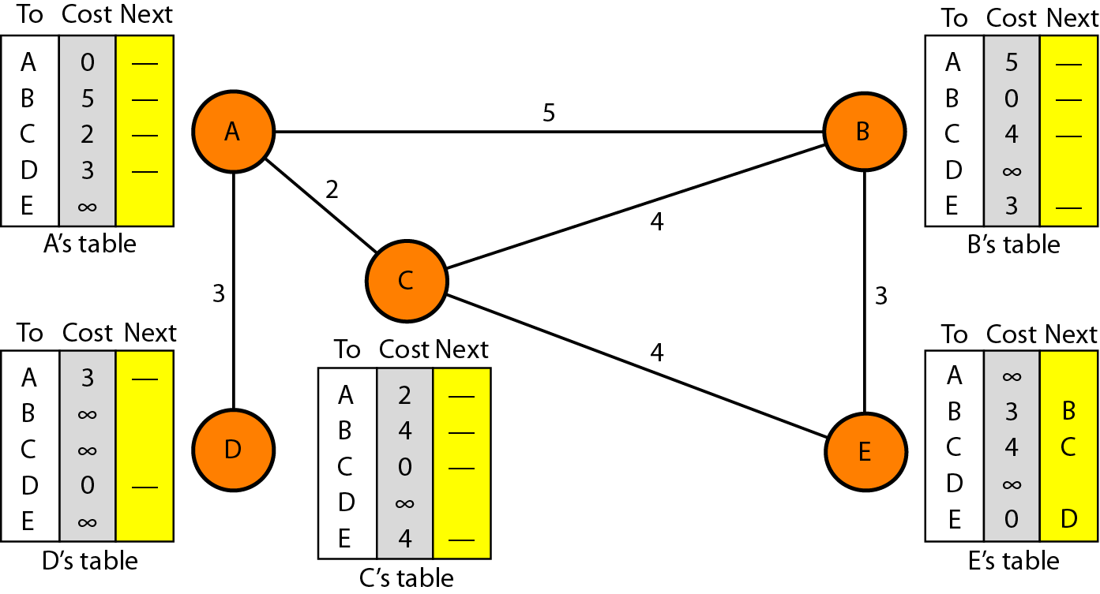
Initialization of tables in distance vector routing

Slide 9

Note
In distance vector routing, each node shares its routing table with its
immediate neighbors periodically and when there is a change.

Slide 10
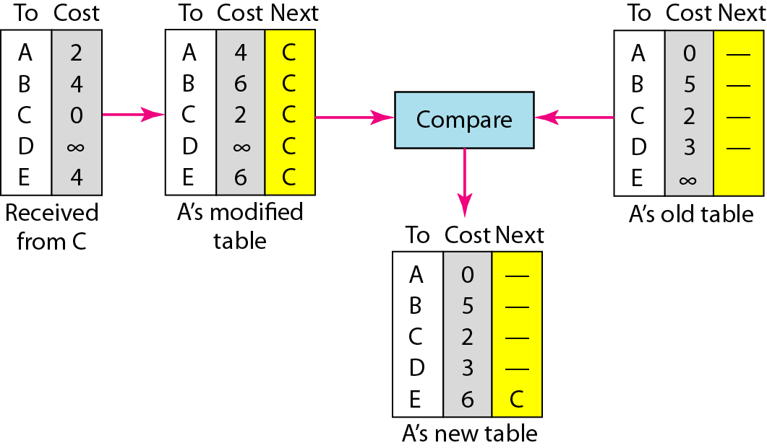
Updating in distance vector routing

Slide 11
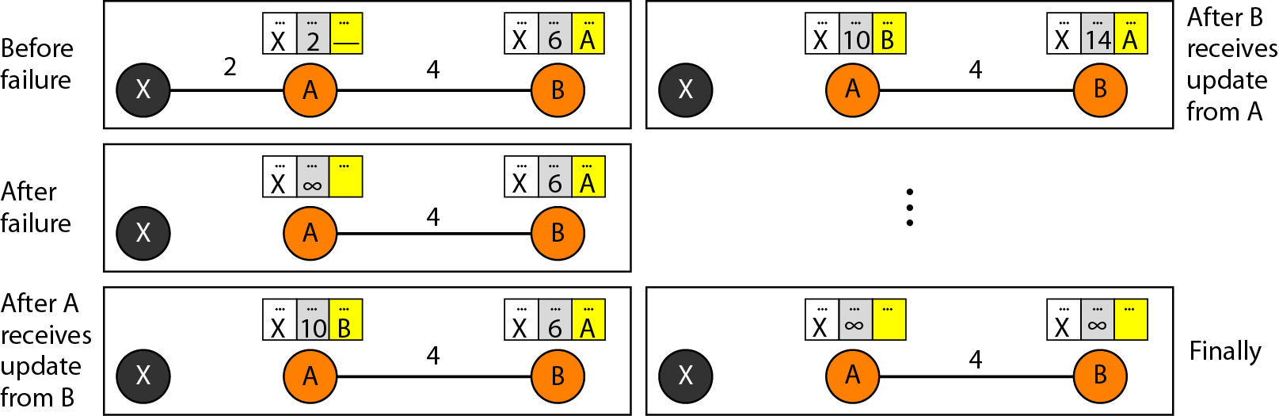
Two-node instability

Slide 12
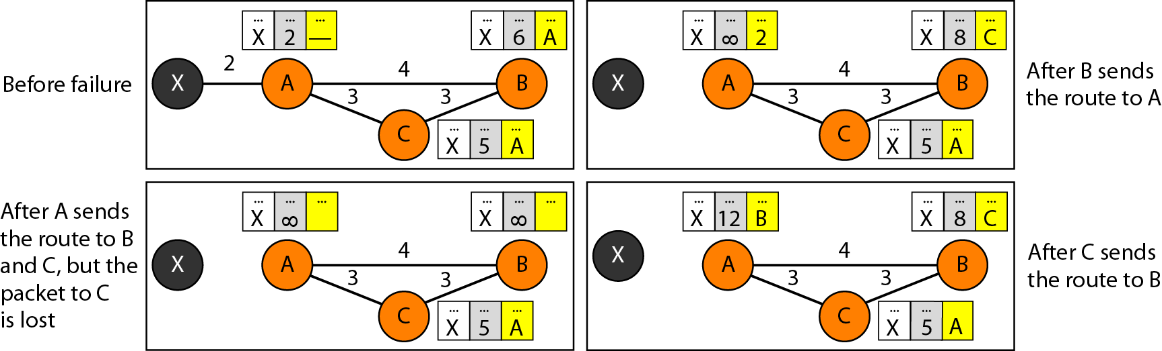
Three-node instability

Slide 13
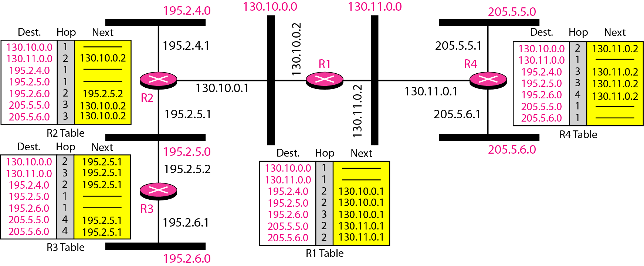
Example of a domain using RIP

Slide 14
Link State Routing
Each router must do the following:
Discover its neighbors, learn their network address.
Measure the delay or cost to each of its neighbors.
Construct a packet telling all it has just learned.
Send this packet to all other routers.
Compute the shortest path to every other router.
A complete topology is developed. Then Dijkstra’s Algorithm can be used to compute the shortest path.
Following 5 steps are followed to implement it.
Learning about the Neighbors
Measuring Line Cost.
Building Link State Packets.
Distributing the Link State Packets.
Computing the New Routes.

Slide 15
Difference between Link State and Distance Vector
Link State | Distance Vector
link states algorithm is an algorithm using global information | the distance vector algorithm is iterative, asynchronous, and distributed
each node talks with all other nodes, but tell them only the cost of it's directly comparison of some of their attribute | each node talks to only its directly connected neighbors, but provides its neighbor with least cost estimates from itself to all the nodes.
Message complexity: With link state, every node has to keep the information about the cost of each link within the network. | Message complexity: with distance vector algorithm, message is exchanged between two hosts which are directly connected to each other.
very times, if any of the link cost is changed, all the nodes are updated. | change of cost in the link which is belong to the least cost path for one of the nodes, the DV algorithm will update the new value. But if the change doesn't belong to the least cost part between 2 hosts, there will no updating.
Speed of convergence: can converge faster in comparison of later. | Speed of convergence: can converge slowly and have routing loops while the algorithm is converging.
Such probability is less. | DV algorithm also suffers from the count to infinity problem.
Robustness: For LS, when a router is down, it can broadcast a wrong cost for the closest one. LS node is computing for its own forwarding table and other node do the calculation for themselves. Better than DV. | Robustness: DV, the wrong least cost path can be passed to more than one or all of the node so the wrong calculation will be process in the entire net work. This problem of DV is much worse than LS algorithm.

Slide 16
Step 1: Learning about the Neighbours:
Upon boot of router,
Send HELLO packet on each point-to-point line
Routers are supposed to send reply with a globally unique name
Step 2: Measuring the Line Cost:
Measure round-trip delay using ECHO Packet and wait for its reply
Take load into account? Yes. Arguments both ways: when choice is given to router having same number of hops from S to D.
Yes! preference for unloaded line as shortest path.
No! where oscillations are possible.
Better Solution? Distribute Load over multiple lines.

Slide 17
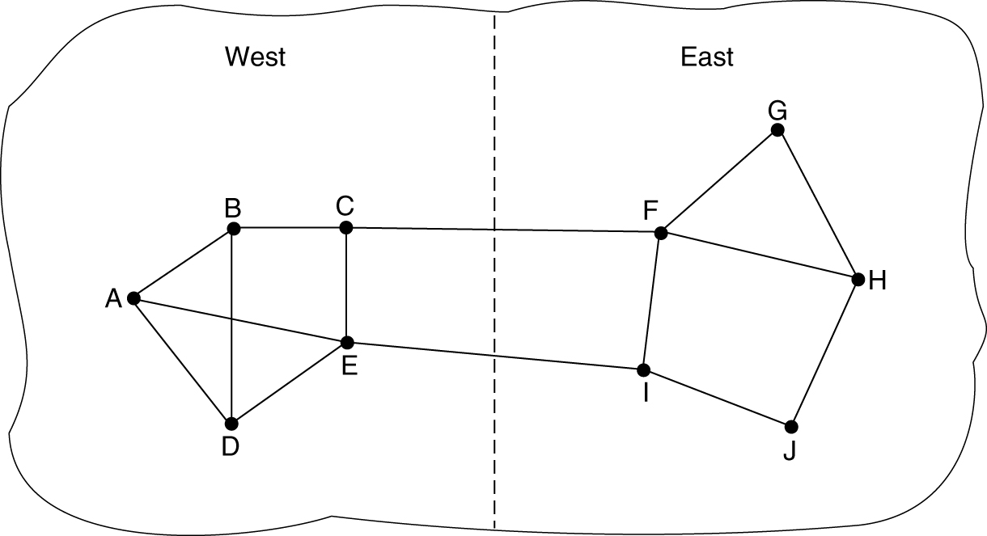
Measuring Line Cost
A subnet in which the East and West parts are connected by two lines.

Slide 18
Step 3: Building Link State Packets:
Packet containing:
Identity of sender
Sequence number + age
For each neighbour:
name + distance
When to build the link state packets?
Periodically
when significant events occur
See next figure.

Slide 19
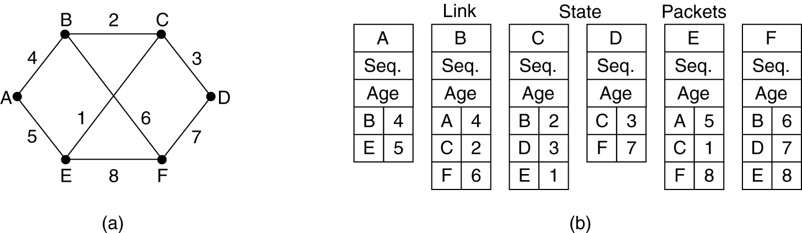
Building Link State Packets
(a) A subnet. (b) The link state packets for this subnet.

Slide 20
Step 4: Distributing Link State Packets:
Distributing link state packets
Trickiest part of algorithm
Arrival time for packets different
How to keep consistent routing tables?
Basic algorithm
Flooding +
Sequence number (in each packet) to limit duplicates.
Manageable problems
Wrap around of sequence numbers results to wrong data. Solution? Use 32 bit sequence number.
Wrong sequence number used in case of :
lost in case of crash
Corrupted data transmitted.
Solution? include the age of each packet after the sequence number and decrement it once per second. When the age hits zero, the information from that router is discarded.
duplicates are discarded
Old packets are thrown out

Slide 21
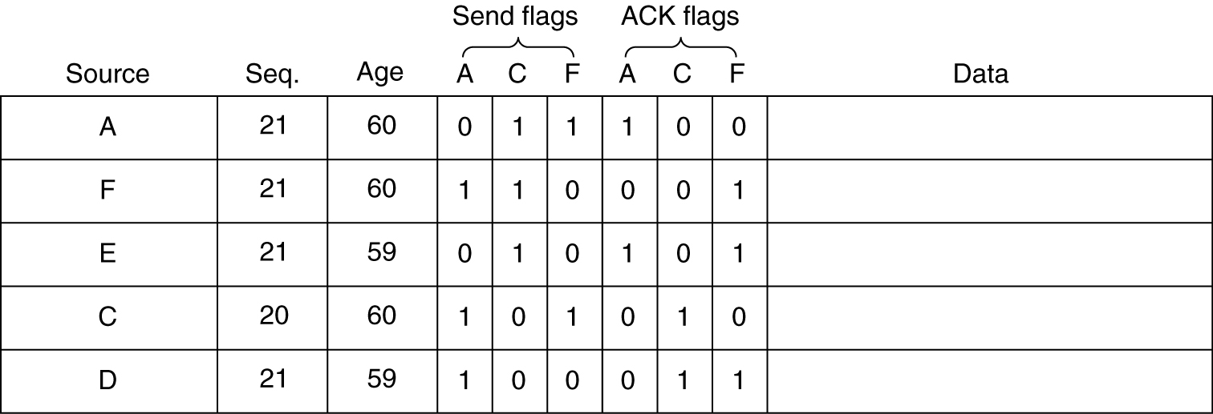
Distributing the Link State Packets
The packet buffer for router B in the previous slide.

Slide 22
Step 5: Computing new routes:
With a full set of link state packets, a router can:
Construct the entire subnet graph
Run Dijkstra’s algorithm to compute the shortest path to each destination
Problems for large subnets
Memory to store data
Compute time for developing these tables.
Usage:
IS-IS protocol (Intermediate System, Intermediate System)
Designed for DECnet(digital equipment corporation network protocol suite), adopted by ISO(international standardization organization), used still in internet.
Supports multiple network layer protocols
OSPF(Open Shortest Path First) protocol used in Internet
Common features:
Self-stabilizing method of flooding link state updates
Concept of a designated router on a LAN
Method of computing and supporting path splitting and multiple metrics.
Useful in Multi Protocol Environment.

Slide 23
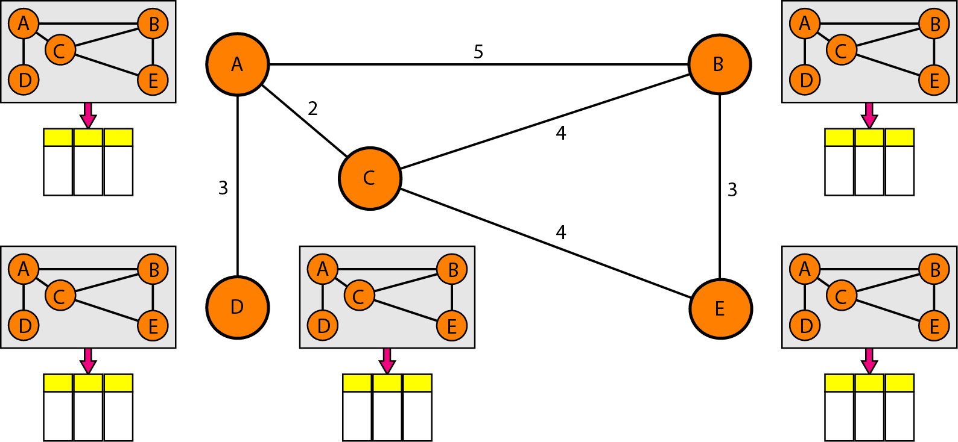
Concept of link state routing

Slide 24
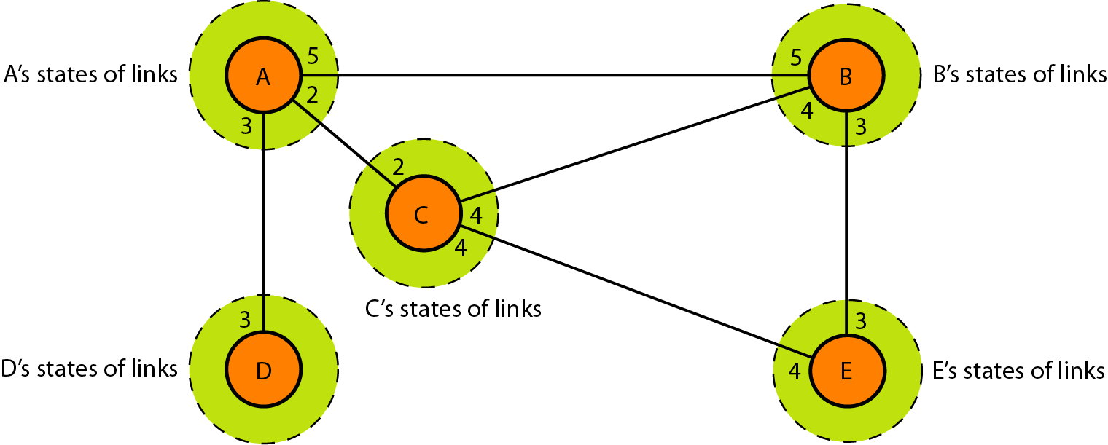
Link state knowledge

Slide 25


